Slide 1
CHAPTER 7 REQUIREMENTS EVOLUTION & MANAGEMENT
SOURCE OF PP SLIDES :
- LAMSWEERDE, A. V. 2011. REQUIREMENTS ENGINEERING: FROM SYSTEM GOALS TO UML MODELS TO SOFTWARE SPECIFICATION. 2ND ED.WILEY.
- WEIGERS, K. AND BEATTY, J. 2013. SOFTWARE REQUIREMENTS. 3RD EDN. MICROSOFT PRESS.

Slide 2

LESSON OBJECTIVES
To understand change management and the impacts of changes
To explain concept of traceability management and evaluate the use of traceability
To understand measurement metrics and tools support for requirement management

Slide 3







Chap.1: RE products and processes
alternative options
Chap. 2 & 3:
Chap. 4:
Evaluation
techniques
consolidated
start
agreed
requirements
requirements
Chap. 6:
Chap. 5:
QA
techniques
Spec/doc
techniques
documented requirements
Chap. 7: Requirements evolution techniques

Slide 4

REQUIREMENTS EVOLUTION AND MANAGEMENT : OUTLINE
Change management
Impacts of requirements changes
Traceability management
Measurement metrics
Scalability
Tools support

Slide 5
WHY DO REQUIREMENTS CHANGE?
Change in software development: as inevitable as difficult to control!
Better understanding: new requirements become apparent
Everything else is changing…
Business
Context
Technologies
Markets
…
Possible responses to change …
Add, modify, or remove requirements

Slide 6

REQUIREMENTS CHANGES MUST BE MANAGED
The problem world keeps changing
organizational changes, new regulations, new opportunities, alternative technologies, evolving priorities & constraints
better understanding of system features, strengths, limitations, defects
Causes changes in objectives, concepts, reqs, assumptions
during RE, during software development, after deployment
Triggers new RE cycle (elicit, evaluate, document, consolidate)
facilitated by change anticipation, traceability management
Information management problem
consistency maintenance, change propagation, versioning
Requirements (change) management = process of anticipating, evaluating, agreeing on, propagating changes in RD items
®

Slide 7
CHANGE MANAGEMENT
Concerned with the procedures, processes, and standards which are used to manage changes to a system requirements
Change management policies may cover
The change request process and the information required to process each change request
The process used to analyse the impact and costs of change and the associated traceability information
The membership of the body that formally considers change requests
Software support (if any) for the change control process
A change request may have a status as well as requirements
E.g., proposed, rejected, accepted, included...

Slide 8
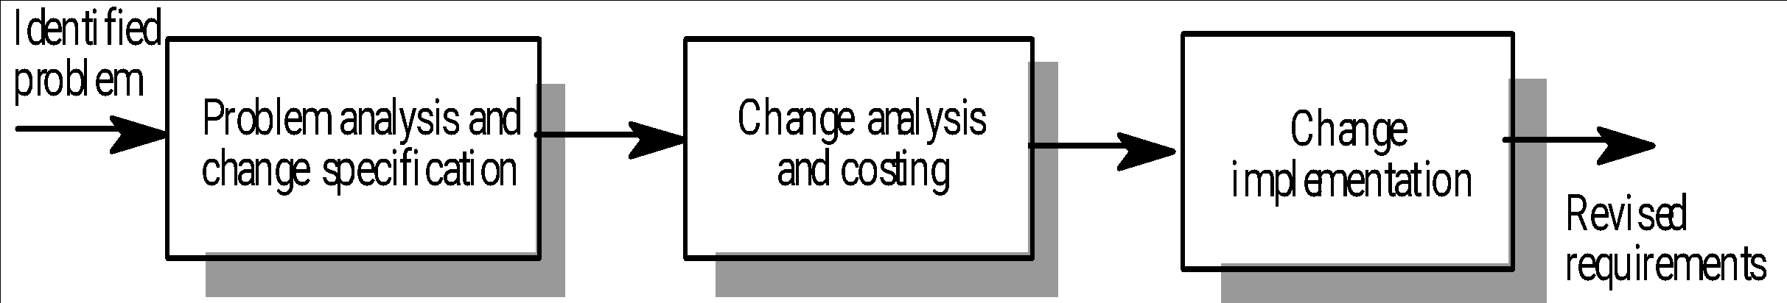
CHANGE MANAGEMENT PROCESS – SUMMARY DIAGRAM
1
2
3

Slide 9

CHANGE MANAGEMENT PROCESS
1
Some requirements problem is identified
Could come from an analysis of the requirements, new customer needs, or operational problems with the system
The requirements are analysed using problem information and requirements changes are proposed
The proposed changes are analysed
How many requirements (and, if necessary, system components) are affected? Roughly how much would cost, in both time and money?
The change is implemented
A set of amendments to the requirements document or a new document version is produced (of course this should be validated with whatever normal quality checking procedures are in place)
2
3

Slide 10

CHANGE MANAGEMENT PROCESS - CHANGE REQUEST FORM
Proposed changes are usually recorded on a change request form which is then passed to all of the people involved in the analysis of the change
Change request forms may include
Date, Customer, Requester, Product including version
Description of change request including rationale
Fields to document the change analysis
Signature fields
Status
Comments

Slide 11
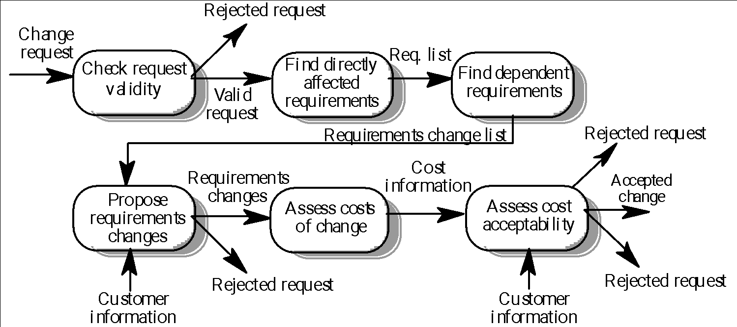
CHANGE MANAGEMENT PROCESS - CHANGE ANALYSIS AND COSTING (EXAMPLE)
customers may misunderstand requirements and their context and suggest unnecessary changes
with the help of traceability information
risk is too high
negotiations with customers
consequential changes may be unacceptable to user/customer
cost/time required for the implementation of change is too high/long
Source of figure: Kotonya and Sommerville

Slide 12

CHANGE MANAGEMENT - TOOL SUPPORT
May be provided through requirements management tools or through configuration management tools
Tool facilities may include:
Electronic change request forms which are filled in by different participants in the process
A database to store and manage requests
A change model which may be instantiated so that people responsible for one stage of the process know who is responsible for the next process activity
Electronic transfer of forms between people with different responsibilities and electronic mail notification when activities have been completed
Electronic signatures
Discussion forums
In some cases, direct links to a requirements database

Slide 13

IMPACTS OF REQUIREMENTS CHANGE
Requirements changing towards the end of development without any impact assessment
Unmatched/outdated requirements specifications causing confusion and unnecessary rework
Time spent coding, writing test cases or documentation for requirements that no longer exist

Slide 14
REQUIREMENTS EVOLUTION AND MANAGEMENT : OUTLINE
Change management
Impacts of requirements changes
Traceability management
Measurement metrics
Scalability
Tools support

Slide 15

TRACEABILITY QUOTES
Requirements traceability refers to the ability to describe and follow the life of a requirement, in both forwards and backwards direction (i.e., from its origins, through its development and specification, to its subsequent deployment and use, and through all periods of ongoing refinement and iteration in any of these phases)”.¹
A software requirements specification is traceable if the origin of each of its requirements is clear and if it facilitates the referencing of each requirement in future development or enhancement documentation.²
[1] Gotel & Finkelstein, 1994; [2] IEEE Standard 830-1998;

Slide 16
TRACEABILITY QUOTES
Traceability gives essential assistance in understanding the relationships that exist within and across software requirements, design, and implementation.³
A link or relationship defined between entities.⁴
Traceability information helps assess the impact of changes to requirements, connecting these requirements as well as requirements for other representations of the system.⁵
[3] Palmer, 2000; [4] Watkins and Neal, 1994; [5] Kotonya and Sommerville

Slide 17

IMPORTANCE OF TRACEABILITY (1)
Requirements cannot be managed effectively without requirements traceability
A requirement is traceable if you can discover who suggested the requirement, why the requirement exists, what requirements are related to it, and how that requirement relates to other information such as systems designs, implementations and user documentation

Slide 18
IMPORTANCE OF TRACEABILITY (2)
Benefits of traceability:
Prevents losing knowledge
Impact analysis
Supports the verification process (certification, localization of defects)
Change control
Process monitoring (e.g., missing links indicate completion level)
Improved software quality (make changes correctly and completely)
Reengineering (define traceability links is a way to record reverse engineering knowledge)
Reuse (by identifying what goes with a requirement: design, code…)
Risk reduction (e.g., if a team member with key knowledge leaves)

Slide 19

TRACEABILITY DIFFICULTIES/ CHALLENGES
Various stakeholders require different information
Huge amount of requirements traceability information must be tracked and maintained
Manual creation of links is very demanding
Likely the most annoying problem
Specialized tools must be used
Integrating heterogeneous models/information from/to different sources (requirements, design, tests, code, documentation, rationales…) is not trivial
Requires organizational commitment (with an understanding of the potential benefits)

Slide 20

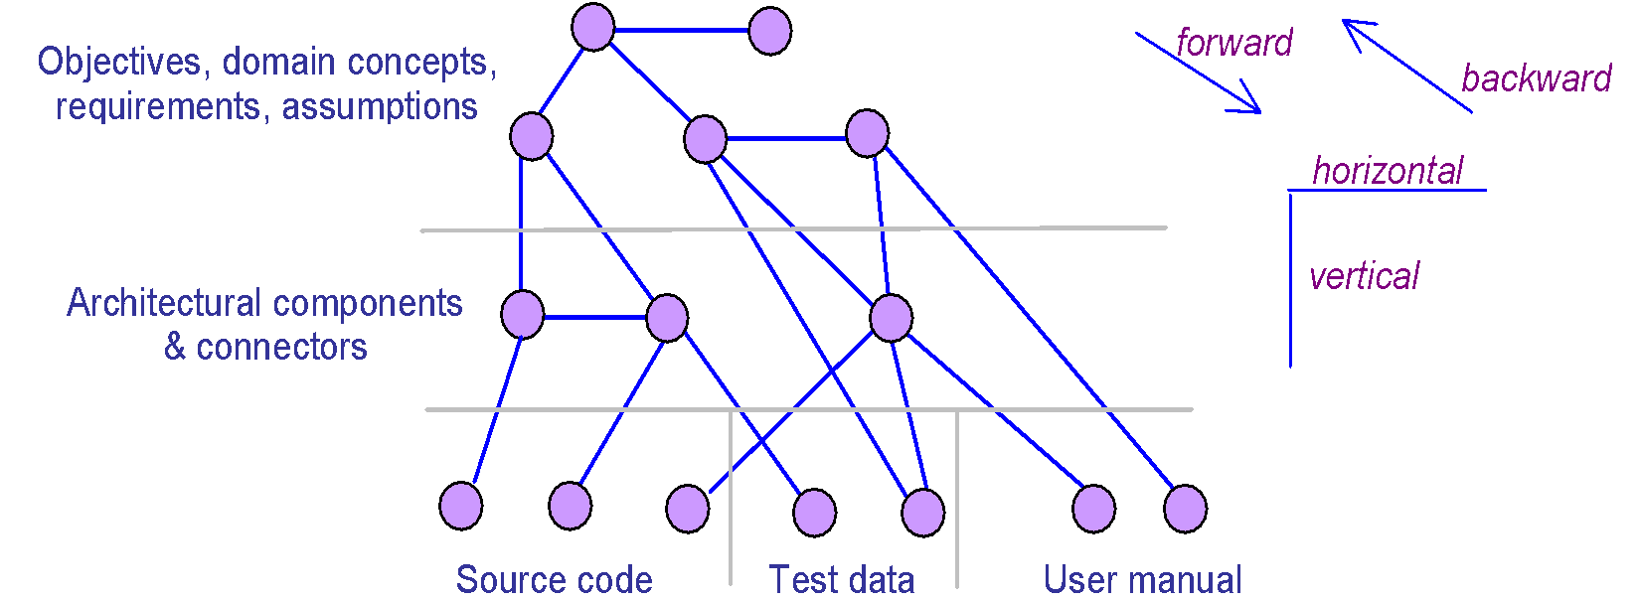
TRACEABILITY MANAGEMENT RELIES ON TRACEABILITY LINKS AMONG ITEMS
To be identified, recorded, retrieved
Bidirectional: for accessibility from ...
source to target (forward traceability)
target to source (backward traceability)
Within same phase (horizontal) or among phases (vertical)
see
book
examples

Slide 21
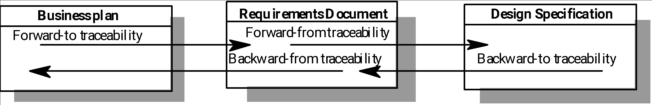
BACKWARD AND FORWARD TRACEABILITY (1)
Why is this here?
Where does it come from?
Backward traceability
To previous stages of development
Depends upon each element explicitly referencing its source in earlier documents
Forward traceability
To all documents spawned by a document
Depends upon each element in the document having a unique name or reference number
Where is this taken into account?
What are the implications of this?
Source of figure: Kotonya and Sommerville

Slide 22

BACKWARD AND FORWARD TRACEABILITY (2)
Top to bottom from requirements’ point of view
Forward-to traceability
Links other documents (which may have preceded the requirements document) to relevant requirements [preceded doc 🡪 req doc]
Help validation
Help evaluate which requirements are affected by changes to users’ needs
Forward-from traceability
Links requirements to the design and implementation components
[red doc 🡪 design/implementation doc]
Help assure that all requirements have been satisfied

Slide 23

BACKWARD AND FORWARD TRACEABILITY (3)
Bottom to top from requirements’ point of view
Backward-to traceability
Links design and implementation components back to requirements
[ design/ implementation doc 🡪 req doc]
Help determine why each item is designed/implemented
Backward-from traceability
Links requirements to their sources in other documents or people
[ req doc 🡪 sources doc/people]
Help validation
Help evaluate how changes to requirements impact stakeholders needs

Slide 24

TYPES OF TRACEABILITY (1)
Requirements – source traceability
Links requirements with a person or document
Requirements – rationale traceability
Requirements – requirements traceability
Links requirements with other requirements which are, in some way, dependent on them
Requirements – architecture traceability
Links requirements with the subsystems where these requirements are implemented (particularly important where subsystems are being developed by different subcontractors)
Requirements – design traceability
Links requirements with specific hardware or software components in the system which are used to implement the requirement

Slide 25
TYPES OF TRACEABILITY (2)
Requirements – interface traceability
Links requirements with the interfaces of external systems which are used in the provision of the requirements
Requirements – feature traceability
Requirements – tests traceability
Links requirements with test cases verifying them (used to verify that the requirement is implemented)
Requirements – code traceability
Generally not directly established, but can be inferred

Slide 26

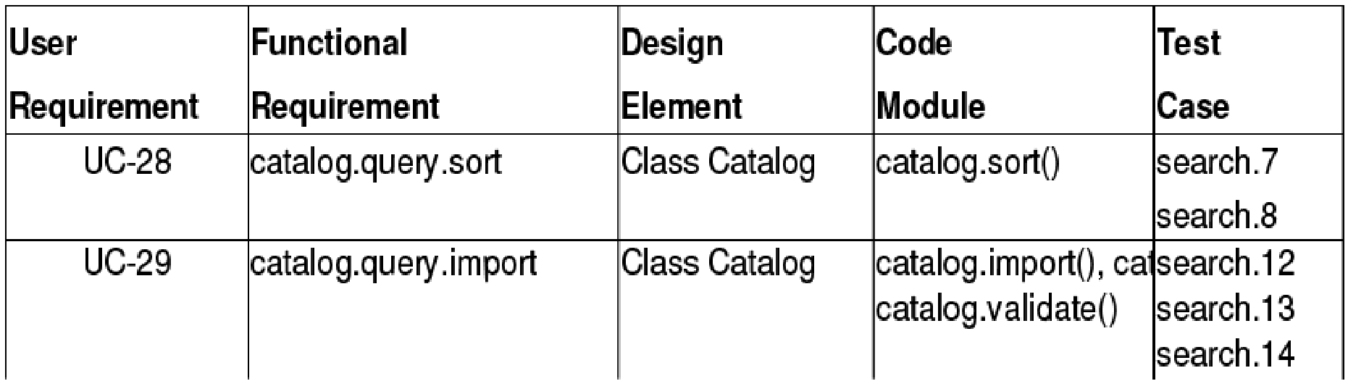
REPRESENTATION – TRACEABILITY TABLE
Show the relationships between requirements or between requirements and other artifacts
Table can be set up to show links between several different elements
Backward and forward traceability
Difficult to capture different types of links

Slide 27
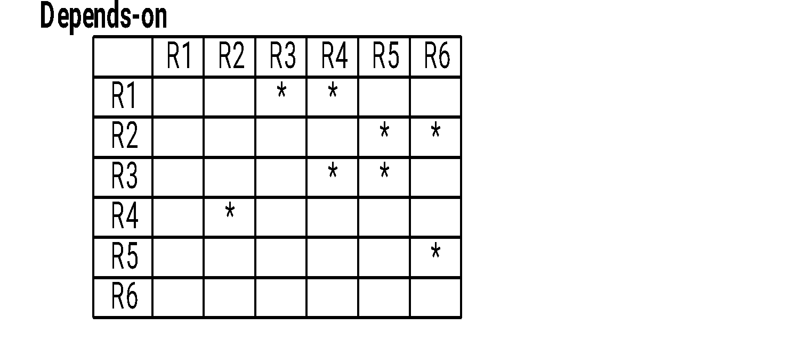
REPRESENTATION – TRACEABILITY MATRIX
Define links between pairs of elements
E.g., requirements to requirement, use case to requirement, requirement to test case…
Can be used to defined relationships between pairs
E.g., specifies/is specified by, depends on, is parent of, constrains…
More amenable to automation than traceability table

Slide 28
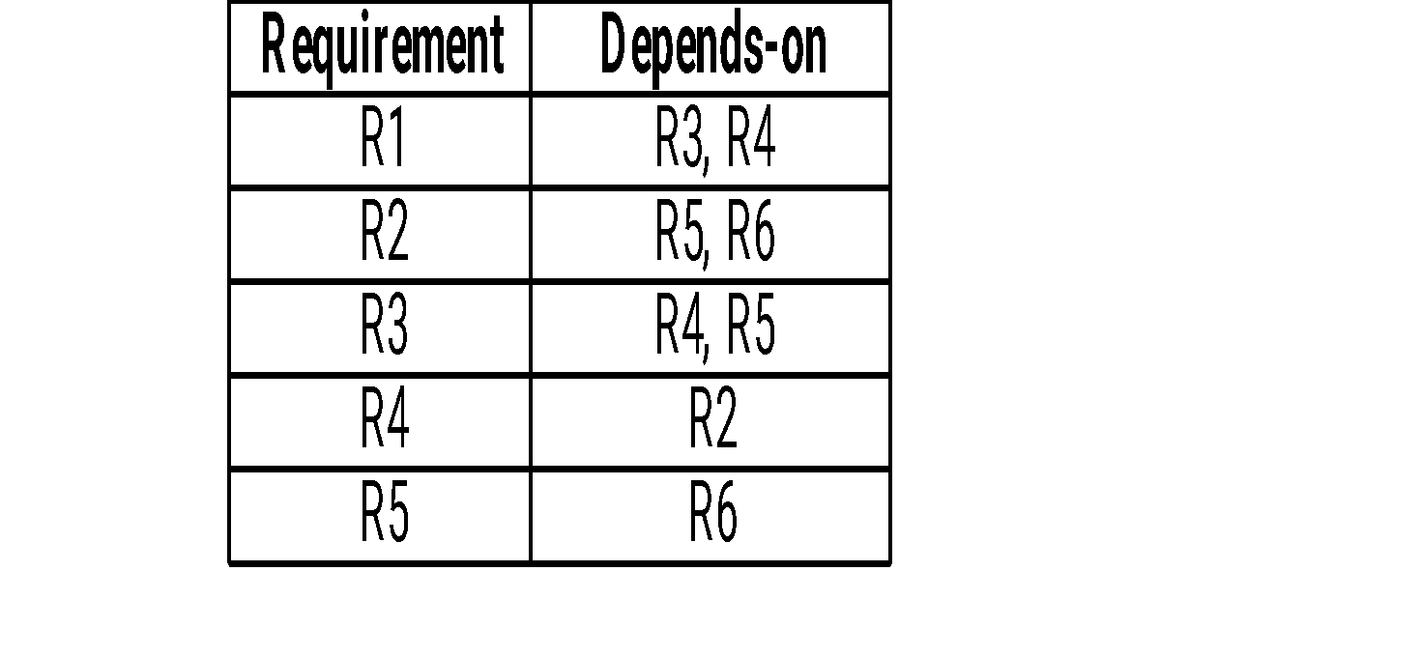
REPRESENTATION –TRACEABILITY LIST
Traceability matrices become more of a problem when there are hundreds or thousands of requirements as the matrices become large and are sparsely populated
A simplified form of a traceability matrix may be used where, along with each requirement description, one or more lists of the identifiers of related requirements are maintained

Slide 29
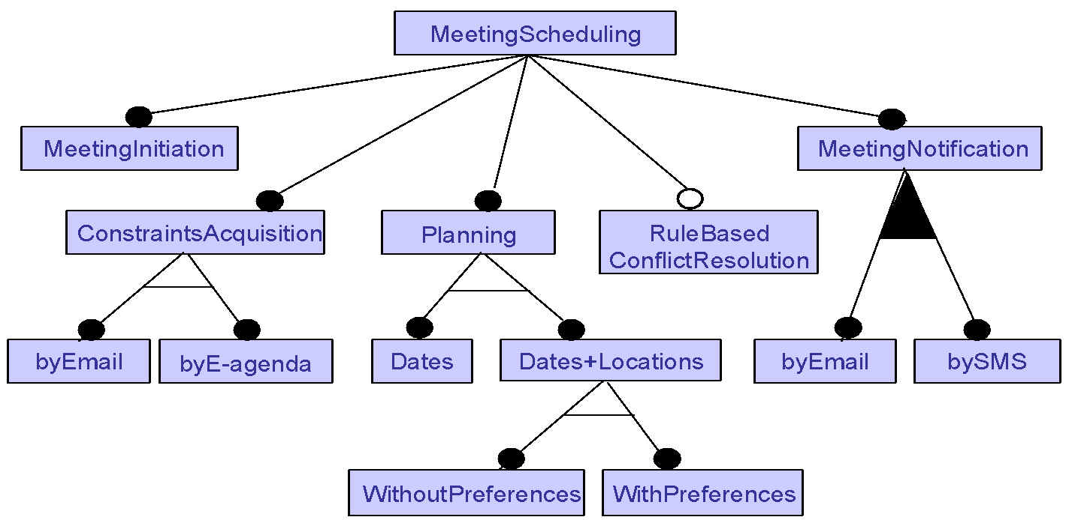
REPRESENTATION - FEATURE DIAGRAMS
For Variant link type: graphical representation of commonalities
& variations in system family
feature aggregation
mandatory
optional
exclusive OR
non-exclusive OR
☺ Compact representation of large number of variants:
1 (MeetingInitiation) × 2 (ConstraintsAcquisition) × 3 (Planning)
× 2 (ConflictResolution) × 3 (MeetingNotification) = 36 variants

Slide 30
TRACEABILITY PLANNING
Planning traceability? - Yes, just like any other project!
Who are the stakeholders?
What are the needs (analysis, reports…)?
Useful, measurable, feasible objectives
Definition of links and attributes
Can some be inferred automatically?
Process (who collects and when to collect traceability information)
Roles, access
Data/link input and updates
Exceptional situations (e.g., lack of time)
Representations, queries, tools
…
Traceability policies define what and how traceability information should be maintained

Slide 31
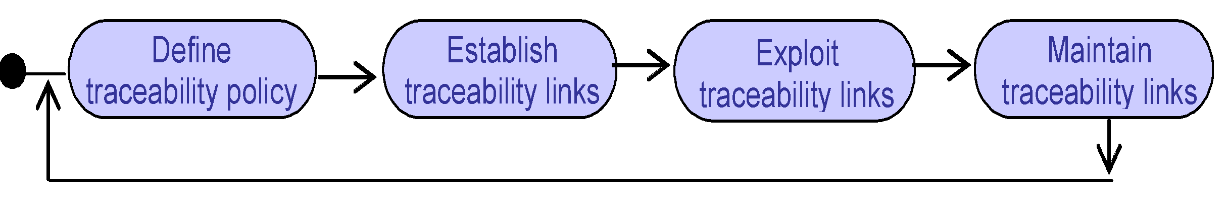
TRACEABILITY PROCESS – LET’S DISCUSS DURING LECTURE

Slide 32
REQUIREMENTS EVOLUTION AND MANAGEMENT : OUTLINE
Change management
Impacts of requirements changes
Traceability management
Measurement metrics
Scalability
Tools support

Slide 33

MEASUREMENT METRICS
RE metrics may be used to provide guidance on improving the RE process – from full life cycle to specific RE artifacts
Measurements can be used to perform analyses that are compared to benchmark values
2 main categories of metrics : Project metrics and Quality metrics

Slide 34

PROJECT METRICS
Use to management, assist in understanding progress and productivity
Used for day-to-day evaluation of project status, and to determine the completeness of an artifact or task to trigger the review process
Eg:
Completeness – An indication of project progress
Coverage – Indicates percent overall project completion

Slide 35

QUALITY METRICS
Provides information on the quality of the various work product
Use to measure the quality of the requirements artifacts but do not necessarily convey information about project progress or productivity
Eg:
Derivation – all requirements are traceable back to stakeholder requests
Requirement quality – Percent of requirements passing a first review

Slide 36

SCALABILITY
Processes put in place at the beginning may not take into consideration the number of requirements
For eg: Beginning – 50 features (not large)
At the end – 5000 features (very large)
due to explosion of each feature
Such large numbers of requirements to manage and trace is not unreasonable for today’s large project with the supports of techniques and Requirements Management tools

Slide 37
REQUIREMENTS EVOLUTION AND MANAGEMENT : OUTLINE
Change management
Impacts of requirements changes
Traceability management
Measurement metrics
Scalability
Tools support

Slide 38

REQUIREMENTS MANAGEMENT (RM) TOOLS
Different companies will use different tools, which may or may not be tailored to the requirements management task
Word processor (Microsoft Word with templates…)
Spreadsheet (Microsoft Excel…)
Industrial-strength, commercial RM tools
Internal tools
Open source RM tools
Bug tracking tools
Collaboration tools
Prototyping tools
Modeling tools
Etc

Slide 39
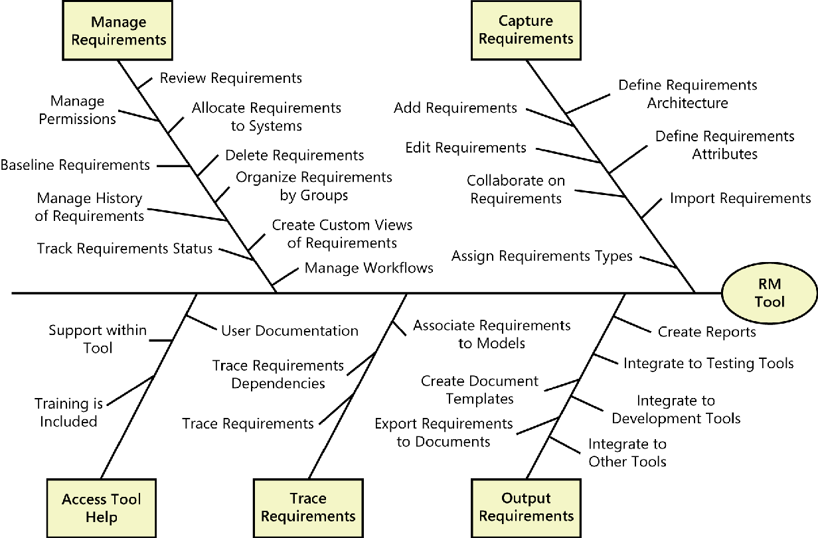
RM TOOL CAPABILITIES

Slide 40
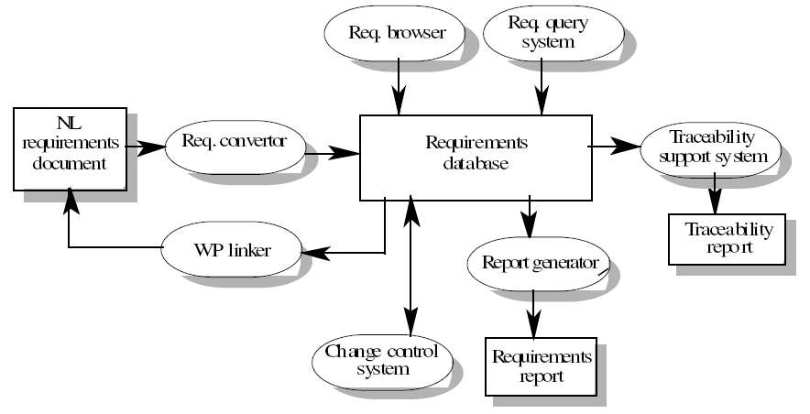
RM TOOL ARCHITECTURE – EXAMPLE

Slide 41
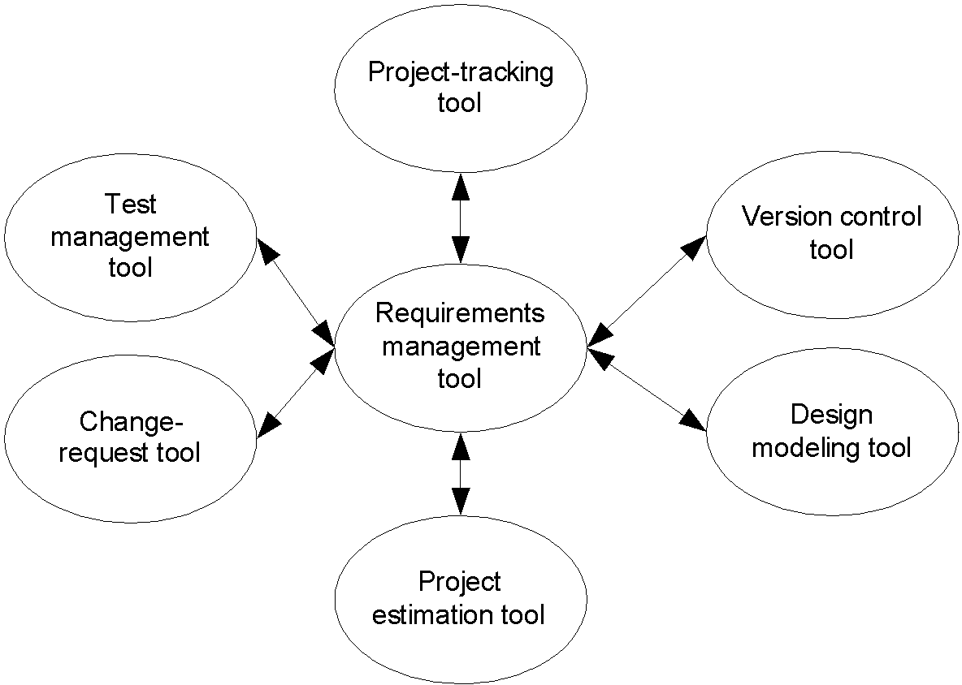
REQUIREMENTS MANAGEMENT IMPLIES INTEGRATION!

Slide 42

WHAT SHOULD WE LOOK FOR IN A TOOL?
Types/attributes for requirements and links
Specifications and models
Version and change management
Database repository
Traceability
Analysis (impact, completeness, style, differences…)
Automatic inspection of requirements (according to rules)
Visualization and reports
Requirements document generation
Monitoring of requirements statuses
Access control
Import/export
Communication with stakeholders
Scripting language (for automation)
Reuse of requirements, models, projects
…

Slide 43

BENEFITS OF USING AN RM TOOL
Manage versions and changes
Store requirements attributes
Facilitate impact analysis
Identify missing and extraneous requirements
Track requirements status
Control Access
Communicate with stakeholders
Reuse requirements
Track issues status

Slide 44

ANY QUESTION…

